Slide 1
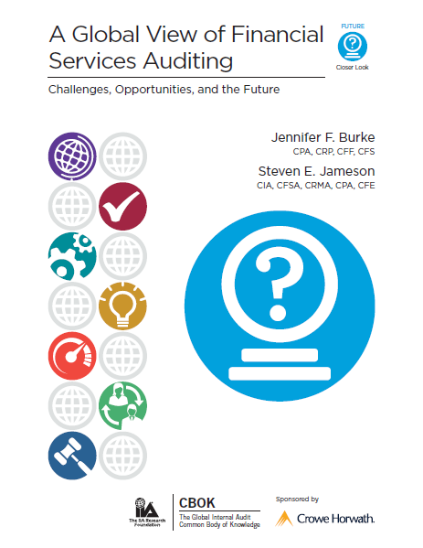
A Global View of Financial Services Auditing: Challenges, Opportunities, and the Future
By
Jennifer F. Burke
and
Steven E. Jameson
Available free of charge:
www.theiia.org/goto/CBOK
Notes:
The IIARF encourages those who are presenting this slideshow to download the full report from The IIA Research Foundation and make it available to their audience.
Based on the time available for the presentation the presenter/group discussion leader may want to focus on the top 3-5 risks identified from their perspective. Also, the presenter should briefly mention the other risks listed in the report and encourage attendees to consider their organization’s IT risks, threats and vulnerabilities in relation to the report and compare those during the next annual risk assessment. Finally, it is suggested that you compare your organization’s action steps to reduce risk to an acceptable level (based on your organization’s risk appetite). Please remember for each section a list of key questions for IA to ask is provided to help gather information and a list of key activities is also provided for IA to perform.

Slide 2
CBOK 2015 Practitioner Study
CBOK is the Global Internal Audit Common Body of Knowledge:
The global practitioner survey is the largest ongoing study of internal audit professionals in the world.
More than 25 free reports about practitioners and the profession will be released from July 2015 to July 2016.
Download free reports from the CBOK Resource Exchange at The IIA website at any time (www.theiia.org/goto/CBOK).
Notes:
Review what CBOK is & how it benefits the Internal Audit profession. Emphasis the number of participants from all over the world and that the 25 CBOK reports are provided to members/other interested parties to further the profession and strengthen overall organizational governance.

Slide 3
CBOK 2015 Practitioner Survey
Practitioner Survey Results
Survey completed April 1, 2015
14,518 usable survey responses
Participation Levels
100% representation from IIA institutes
Responses from 166 countries
23 languages

Slide 4
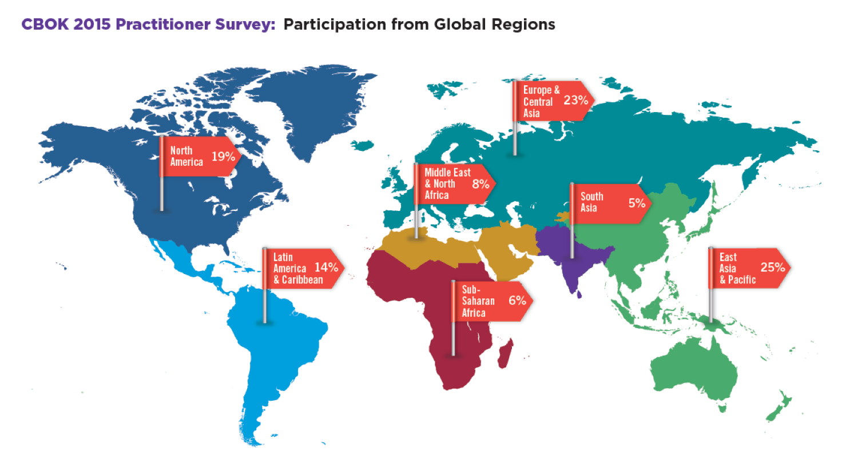
CBOK 2015 Practitioner Study
Notes:
Global Regions are based on World Bank Categories. Percentages are the percentage of total survey responses from that region compared to all survey responses.
North America: 19%
Latin America & Caribbean: 14%
Middle East & North Africa: 8%
Sub-Saharan Africa: 6%
Europe & Central Asia: 23%
South Asia: 5%
East Asia & Pacific: 25%

Slide 5
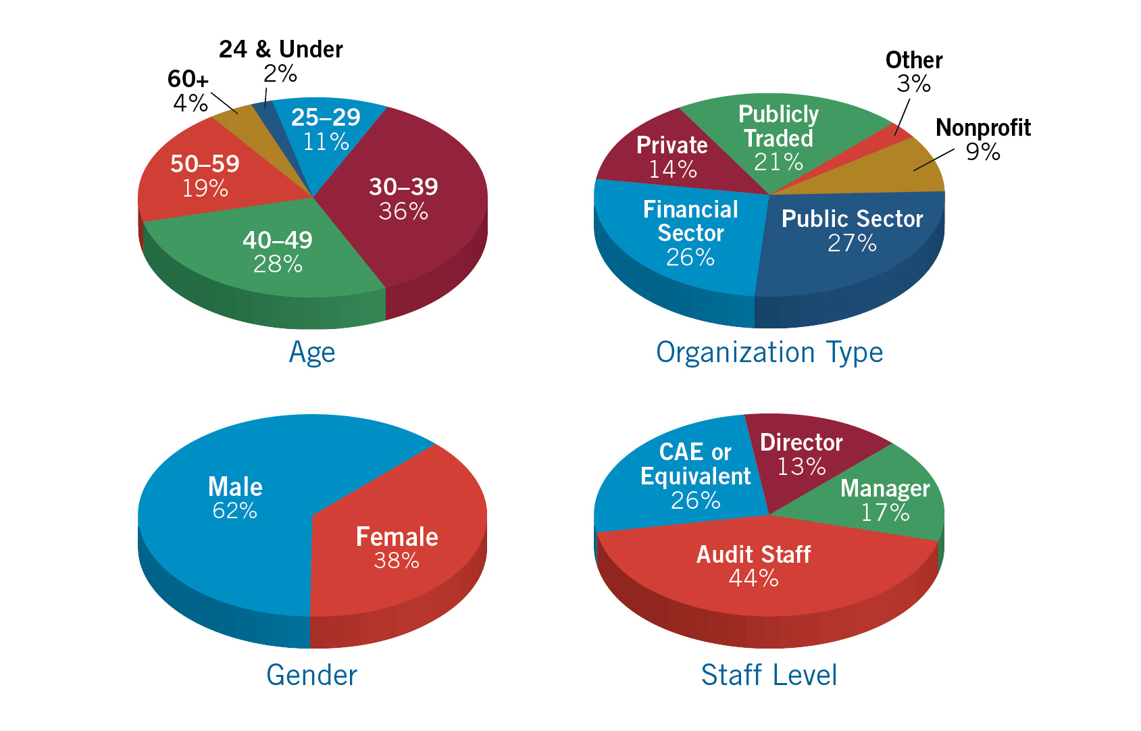
CBOK 2015 Practitioner Study
Age was obtained from 12,780 respondents; Organization Type was obtained from 13,032 respondents; Gender was obtained from 14,357 respondents; Staff Level was obtained from 12,716 respondents.
Notes:
The speaker does not necessarily need to say this, but it’s important to remember that each pie chart is based only on those who answered that particular question (in other words, not all 14,518 survey respondents provided an answer to every question.) Below are the specific number of responses for each question shown on the slide.
Age was obtained from 12,780 respondents; Organization Type was obtained from 13,032 respondents; Gender was obtained from 14,357 respondents; Staff Level was obtained from 12,716 respondents.

Slide 6
Executive Summary
Regulatory Challenges for Financial Services Internal Auditors
Crowded Audit and Risk Committee Agendas
Challenges Due to Elevation of Internal Audit
Increased Technology Risks
Three Lines of Defense
Internal Audit Resources
Conclusion

Slide 7
Executive Summary
Times are more challenging than ever
Workloads have expanded
Elevated roles have led to heightened expectations
Technology is expanding quickly
New defense models
Staffing challenges

Slide 8
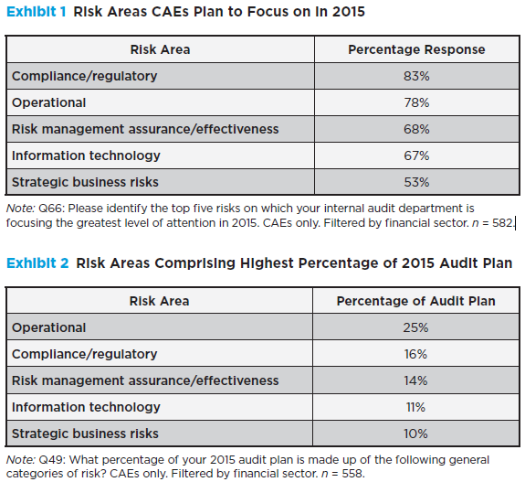
Regulatory Challenges
Compliance/regulatory and operational risks were top risk areas CAEs intend to focus on in 2015 and comprise highest % of 2015 audit plan.
New regulatory agencies have been created.
Laws/regulations have been enacted with ever-increasing volume and frequency (“regulation by enforcement”).

Slide 9
Regulatory Challenges
Record penalties
More focus on compliance issues by internal audit
“Due to scrutiny of banks, regulators are increasing their reliance on internal audit and hence many banks are considering creating specific audit teams to concentrate only on regulator requests.” –Jenitha John, CAE, FirstRand, South Africa
“Wall Street banks and their foreign rivals have paid out $100 billion in U.S. legal settlements since the financial crisis…” –FinancialTimes.com, 3/25/14

Slide 10
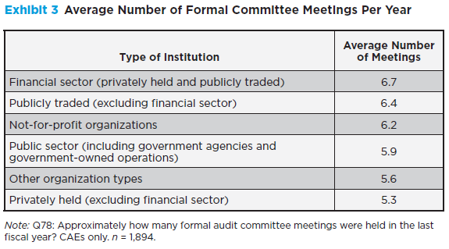
Crowded Audit and Risk Committee Agendas
Agendas are expanding.
Shareholder and investor expectations continue to grow.
Regulatory expectations show no signs of diminishing.
Boards rely on audit/risk committees to help satisfy fiduciary responsibilities and provide some protection against lawsuits and regulatory actions.

Slide 11
Challenges Due to Elevation of IA
Good news: IA is increasingly elevated in stature and recognition
Increased weight and importance assigned to audit recommendations
More interaction with executives and board members
First-hand knowledge of and input to strategic initiatives
Bad news: IA is increasingly elevated in stature and recognition—be careful what you ask for!
Expectations of management, directors, regulators and external auditors have raised the bar
Stakeholders are often at odds, resulting in inconsistent expectations
Compliance with IIA Standards is no longer enough
More assistance provided to external auditors and regulators
Regulatory expectation for IA to “challenge” management
69% of financial services internal auditors report to the audit committee; 54% across all industries

Slide 12
Increased Technology Risks
Technological capabilities are growing faster than organizations can digest, interpret, assess, and control.
Today’s bank robbers come armed with technology instead of guns 24/7/365 from anywhere.
Internal auditors in financial sector have much higher levels of activity for general IT risks.
Heavily publicized data breaches increase reputation risk—a matter of “when” you are breached, not “if” you are breached.
Financial sector sees risk of data breach as more extensive than other sectors (43% vs. 34%).
Big data must be stored, managed, and protected.
Connectedness—controlling access is no longer limited to locking down workstations.
Having internal expertise on staff to address ever-changing technology risks is challenging.

Slide 13
Three Lines of Defense
78% of financial sector worldwide follow model.
All lines should exist—strongest when separate and clearly defined.
When blended approach exists, apply safeguards:
Report to AC directly.
Communicate and document potential risks of combining lines.
Consider an executive to whom all internal assurance groups report directly.

Slide 14
Internal Audit Resources Challenges
Knowledge expectations are broader for IA today: technology, business ops, financial services, communications, regulatory compliance, cybersecurity, privacy, vendor management, business continuity, legal matters, quantitative analysis…
Unemployment numbers for auditors and accountants in North America are at an all-time low.
Fewer students are electing degrees in accounting.
Generational differences:
Work and life balance considerations rate higher for younger generations.
Flexible work schedules and more generous leave time are becoming more common.
Rotational CAE approach, while providing benefits, may result in continuity and/or independence issues.

Slide 15
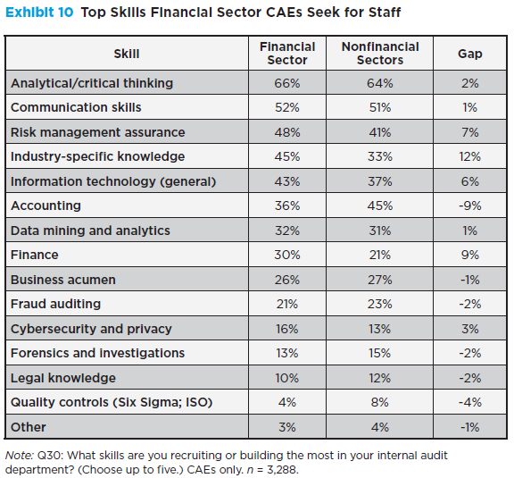
Internal Audit Resources
“In light of financial services audit functions’ need to evolve their focus from financial risks to more operational risks, the backgrounds of those we are recruiting are also evolving…” –Mark Howard, SVP and CAE, USAA, San Antonio, TX

Slide 16
Conclusion
Internal auditors who step up and effectively address the challenges can demonstrate their positive contributions.
They will:
Be recognized as effective leaders and continue to elevate their stature and reputation in the workplace
Likely get additional challenges as their role continues to grow in importance
To Be Successful: Strive for improvement through innovative techniques and practices, professionalism, continual development, and dedication to the profession.

Slide 17
Author Information
Jennifer F. Burke, Partner
Crowe Horwath
859.280.5160 (o)
859.221.2613 (c)
Email: Jennifer.burke@crowehorwath.com
Twitter: @jenniferfburke
Linked In: http://www.linkedin.com/pub/jennifer-burke/3/510/825
Steven E. Jameson
EVP, Chief Internal Audit &
Risk Officer
Community Trust Bancorp, Inc.
606.433.4738 (o)
Email:
jamesost@ctbi.com

Slide 18
CBOK 2015 Releases
IIA Financial Services Exchange
ECIIA Conference
Governance, Risk, and Control Conference
South Africa Conference
All Star Conference
Southern Regional Conference
ACIIA Conference
IIA Midyear Committee Meetings
IIA International Conference
Jul. 2015 | Aug. 2015 | Sept. 2015 | Oct. 2015 | Nov. 2015 | Dec. 2015
Driving Success in a Changing World: 10 Imperatives for Internal Audit | Navigating Technology’s Top 10 Risks: Internal Audit’s Role Staying a Step Ahead: Internal Audit’s Use of Technology | A Global View of Financial Services Audits: Challenges, Opportunities, and the Future | Who Owns Risk? A Look at Internal Audit’s Changing Role Combined Assurance: One Language, One Voice, One View Responding to Fraud: Exploring Where Internal Auditing Stands | Public Sector Outlook | Measuring Internal Audit Value and Performance Core Competency Levels for Internal Auditors Interacting with Audit Committees
Notes:
Please share information about the publication of upcoming CBOK reports and where to go for the free download.

Slide 19
CBOK 2016 Releases
IIA International Conference
Leadership Conference
GAM Conference
SoPac Conference
Jan. 2016 | Feb. 2016 | Mar. 2016 | Apr. 2016 | May 2016 | Jun. 2016
The Skills Most Desired by IA Managers for Their Staffs Use of Third Parties by Internal Audit | CAE Career Path Women in IA: Representation and Trends | Maturity Levels for IA Dept. Around the World How to Evaluate and Motivate Your Staff | Certifications Held by Internal Auditors Ethical Pressures Faced by Internal Auditors | IIA Standards: Conformance and Trends Quality Assurance and Improvement Program Trends | Integrated Reporting Organizational Governance: Internal Audit's Role
Notes:
Additional reports that will be available for a free download..

Slide 20
YOUR DONATION DOLLARS AT WORK
FREE thanks to generous contributions from individuals, organizations, IIA chapters, and IIA institutes around the world.
Download your FREE copy today at the
CBOK Resource Exchange.
www.theiia.org/goto/CBOK
This report was generously
sponsored by
Notes:
The IIARF encourages those who are presenting this slideshow to download the full report from The IIA Research Foundation and make it available to their audience.

Slide 21
About The IIA Research Foundation
CBOK is administered through The IIA Research Foundation (IIARF), which has provided groundbreaking research for the internal audit profession for the past four decades. Through initiatives that explore current issues, emerging trends, and future needs, The IIARF has been a driving force behind the evolution and advancement of the profession.
For more information, visit: www.theiia.org/Research

Slide 22
Copyright and Disclaimer
The IIARF publishes this document for information and educational purposes only. IIARF does not provide legal or accounting advice and makes no warranty as to any legal or accounting results through its publication of this document. When legal or accounting issues arise, professional assistance should be sought and retained.
Copyright © 2015 by The Institute of Internal Auditors Research Foundation (IIARF). All rights reserved. For permission to reproduce or quote, please contact research@theiia.org.

